Slide 1

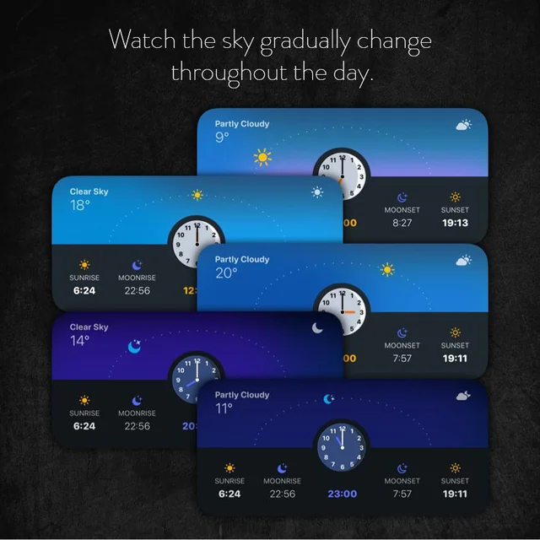
Bayfront weather
Web application
Client – xyz corporation
Bdat 1004 final project
Group 3

Slide 2

About the team
Kriti Prakash Komati
Project role - Developer
Responsibilities:
Develop, design, and rigorously test software systems and applications.
Maintain both front-end and back-end aspects of the software.
Identify and resolve software issues through effective troubleshooting and debugging.
Collaborate closely with project managers, business analysts, and data analysts to align software with project requirements.
Keep abreast of emerging programming languages and technologies for potential project enhancement.

Slide 3

About the team
Anujeet Siwach
Project Role – Data Analyst
Responsibilities –
Gather, validate, and integrate various data sources to support the app's functionality and features.
Collaborate with developers to ensure smooth data integration and compatibility.
Create visual representations, such as charts, graphs, and dashboards, to present data insights to stakeholders.
Assist in identifying and addressing data-related bugs or issues.
Work closely with developers, designers, product managers, and other team members to integrate data-driven insights into the app's design and functionality.

Slide 4

About the team
Bipin Singh Bisht
Project Role –Business Analysts
Responsibilities –
- Gather and analyze requirements from stakeholders.
- Communicate between technical and non-technical teams.
- Prioritize features based on user value and business goals.
- Define functional and non-functional requirements.
- Analyze and ensure accurate weather data sources.
- Research market trends and competitor apps.
- Identify and recommend process improvements.
- Collaborate on testing and quality assurance.
- Collect and incorporate user and stakeholder feedback.

Slide 5

About the team
Ashima Ashima
Project Role –Project Manager
Responsibilities–
Create and manage the project roadmap, encompassing schedules and financial allocations.
Engage stakeholders to align project objectives with their expectations and needs.
Collaborate with team members to guarantee adherence to schedules and prompt task completion.
Mitigate project risks and troubleshoot challenges in a proactive manner.
Monitor and furnish updates on project advancement and achievements.
Assure timely and budget-conscious project delivery that fulfills stakeholder contentment.

Slide 6
contents
Introduction
Purpose and scope
Technologies used
Fetching and storing data
web app – bayfront weather
Fit Gap analysis
conclusions

Slide 7
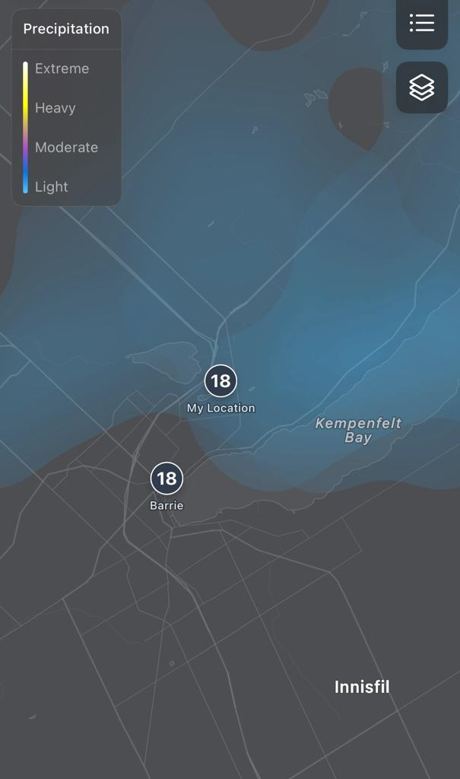
introduction
In a world where the skies are ever-changing and nature's moods are unpredictable, Our mission is simple: to provide you with a comprehensive, intuitive, and delightful weather experience that empowers you to navigate your days with confidence in barrie.
As you step into the world of bayfront weather, you're entering a realm where nature's forces come alive through technology and data.
We bring you real-time weather updates that enable you to plan your day, whether it's a morning jog, a picnic with friends, or a road trip

Slide 8
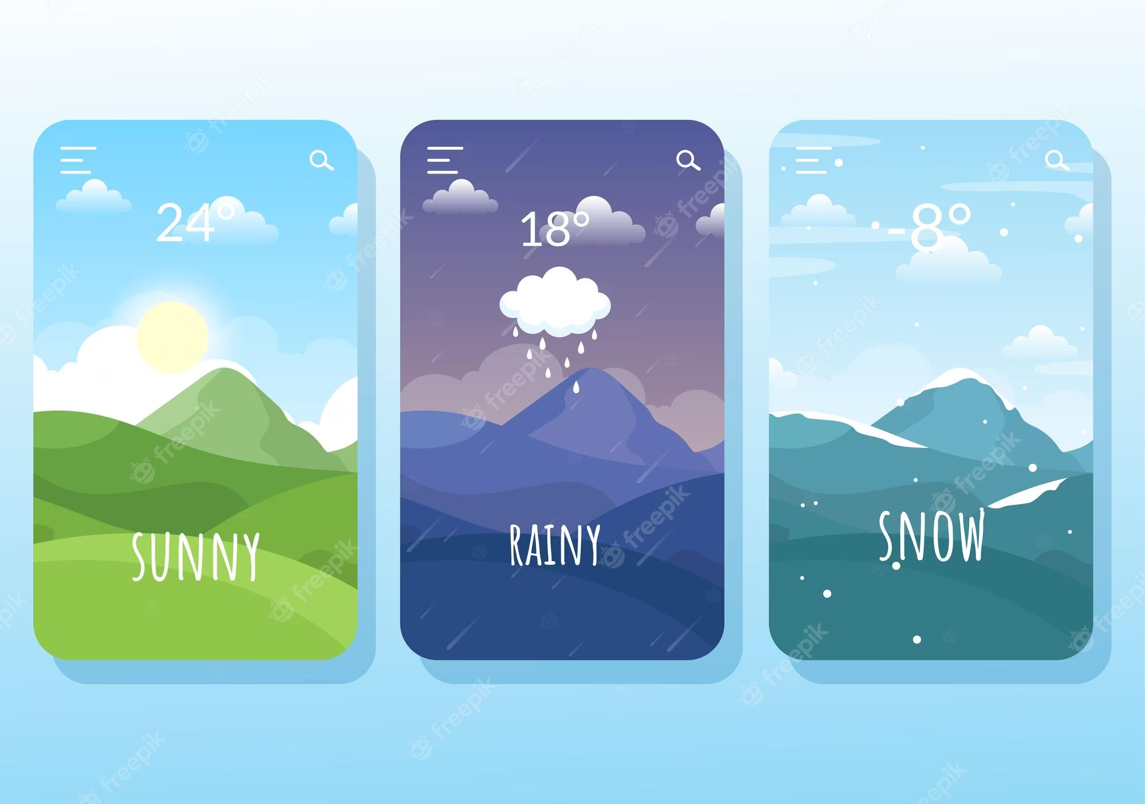
Purpose and scope
The “Bayfront Weather" app is designed to provide accurate and localized weather information specifically for the bayfront area or vicinity. This app offers several compelling reasons for its existence:
Precision forecasting: the app offers highly accurate weather predictions for the bayfront area, ensuring pinpoint accuracy.
Microclimate variability: addressing unique weather patterns influenced by bayfront's geography, the app captures local climate nuances.
Outdoor activities: the app guides outdoor plans, aiding in safe and comfortable experiences like waterfront walks and beach visits.
Tourism and events: catering to tourists and event organizers, the app enhances planning for local activities and gatherings.
Community focus: meeting local concerns, the app fosters a sense of community by providing weather information aligned with residents' needs.
Environmental awareness: including features like air quality and water conditions, the app promotes environmental awareness in the bayfront area.

Slide 9
TECHNOLOGIES USED
PYTHON
MONGO DB
flask
Google charts
html

Slide 10
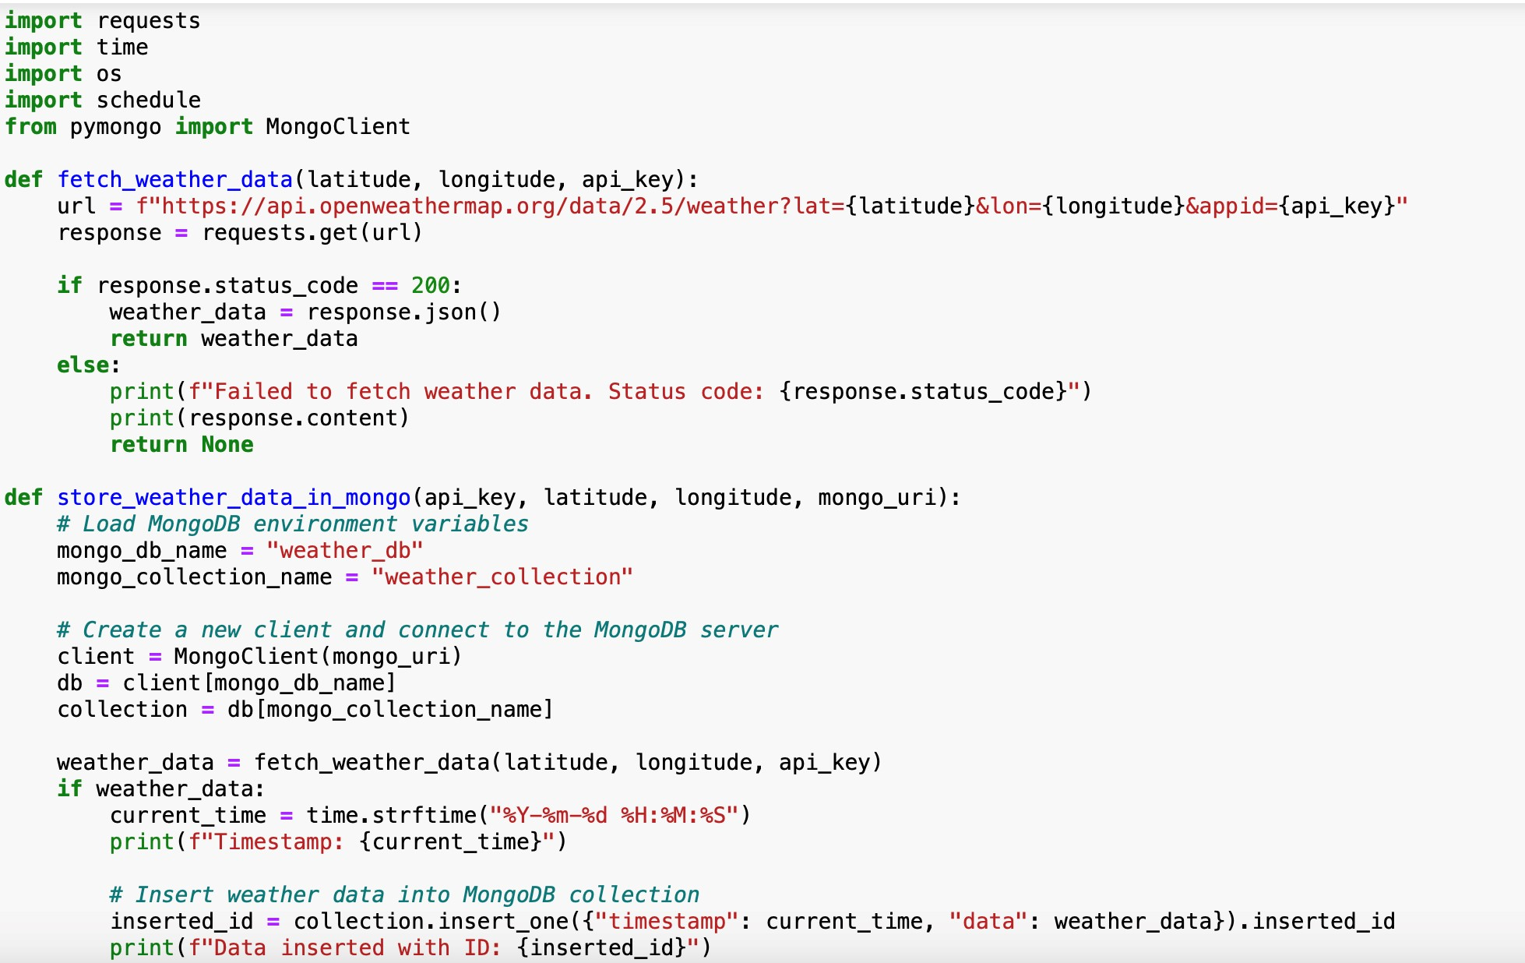
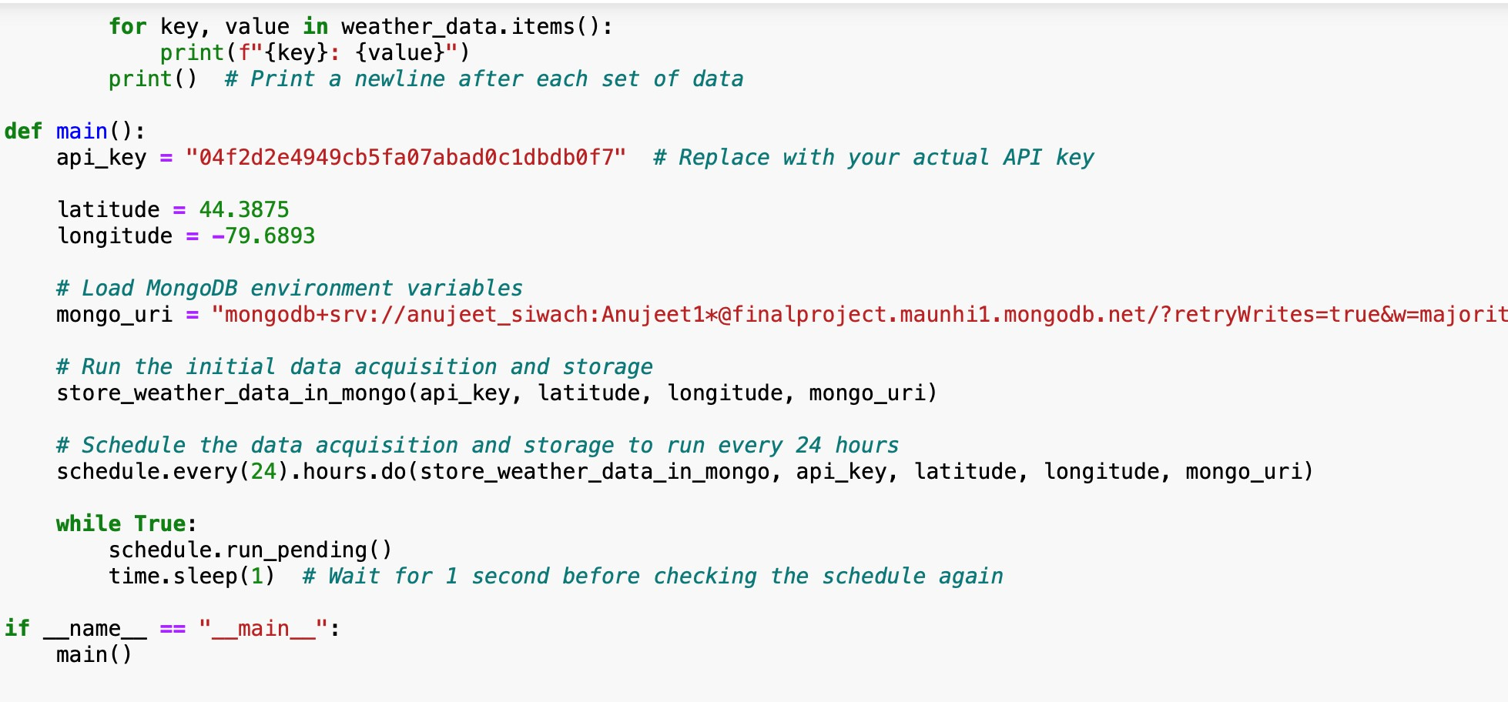
FETCHING AND STORING DATA
Fetching and storing data from an API to MongoDB involves retrieving data from an external source (API) and then saving or inserting that data into a MongoDB database.

Slide 11
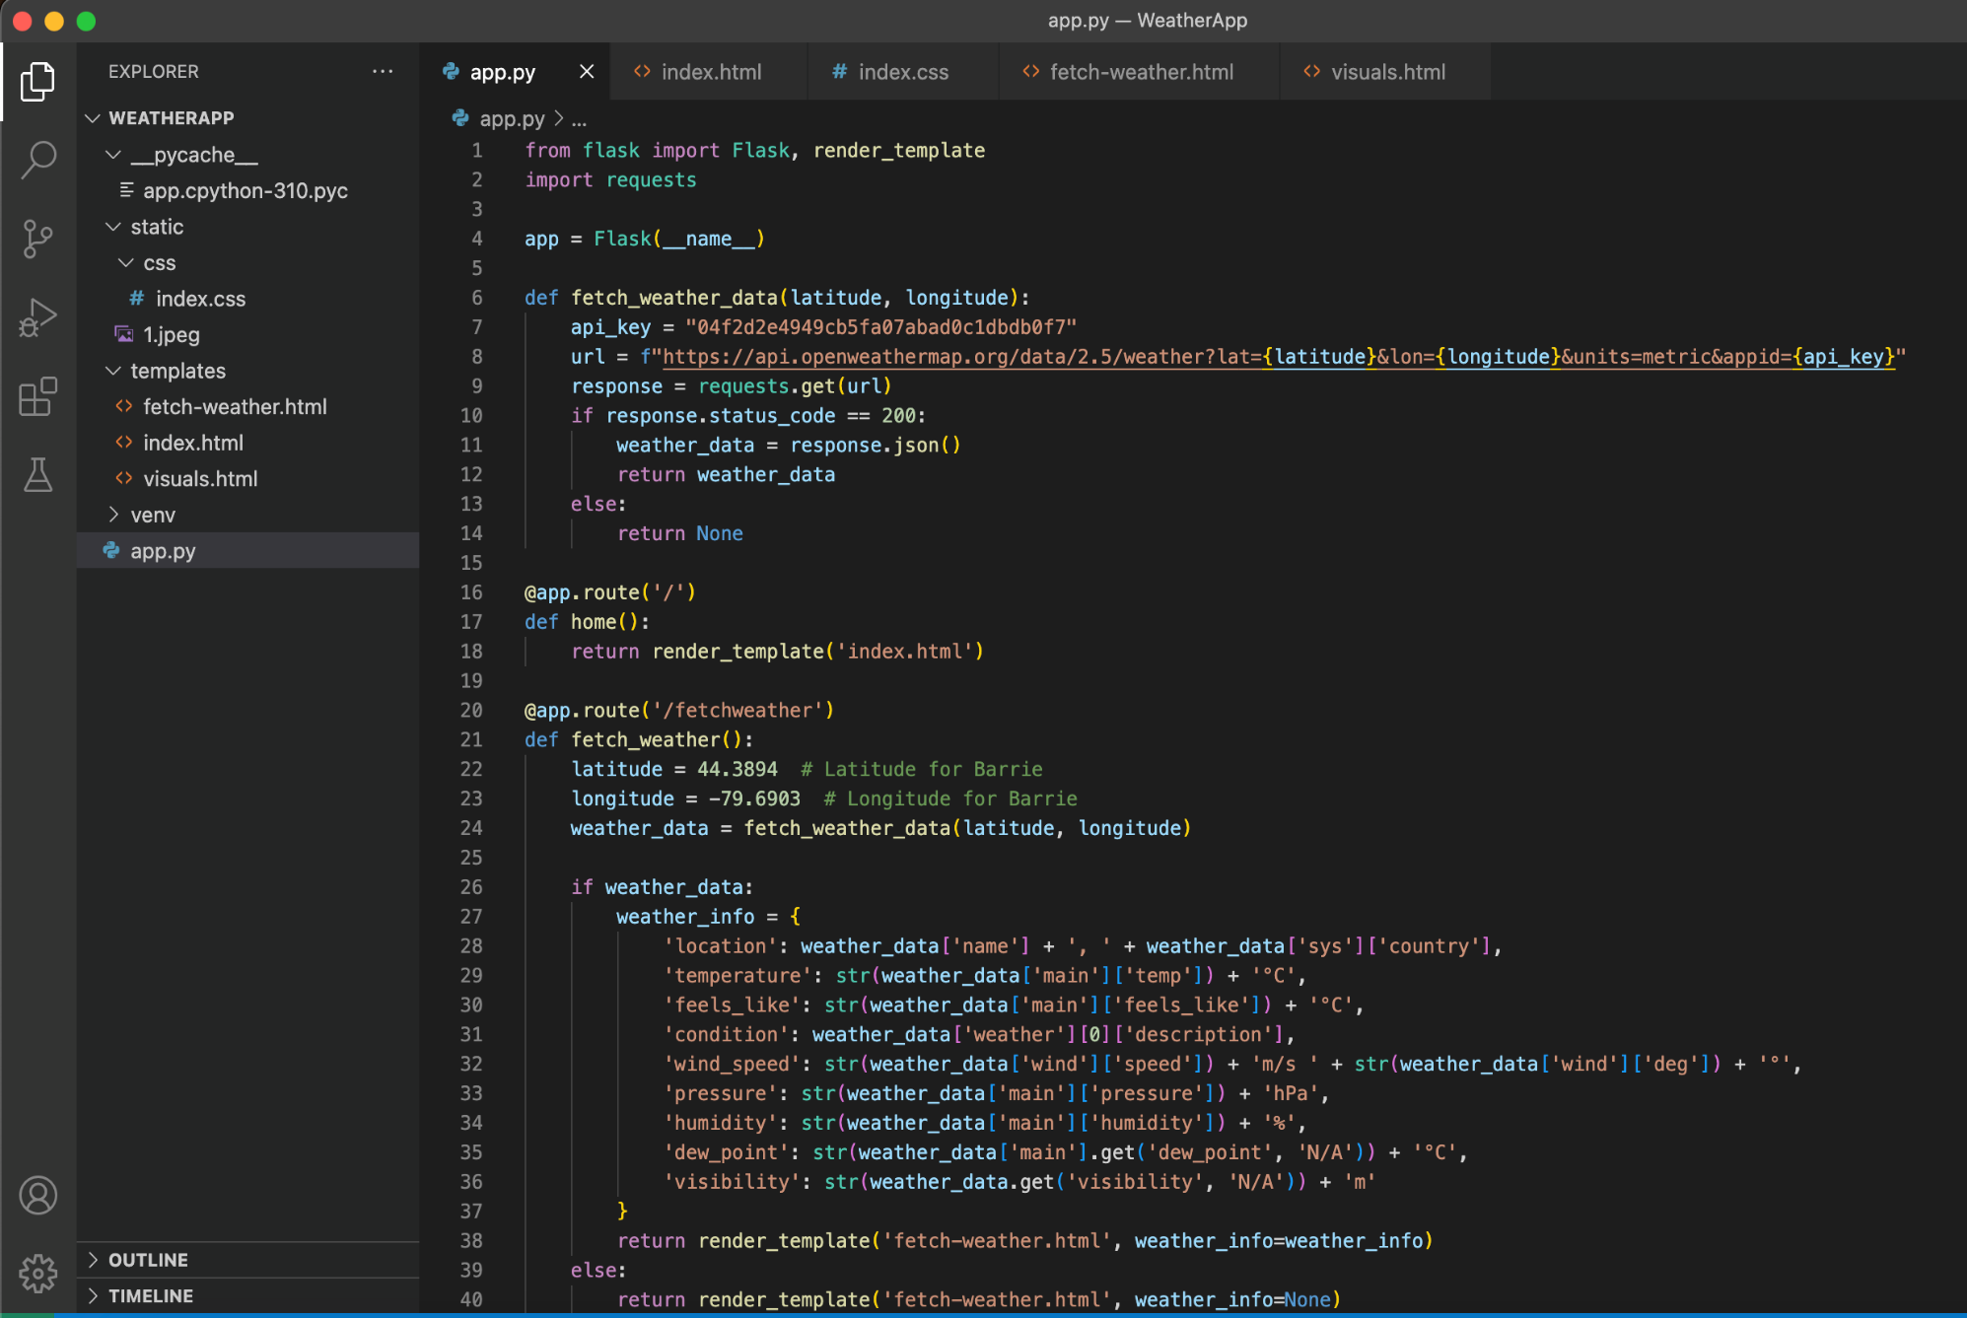
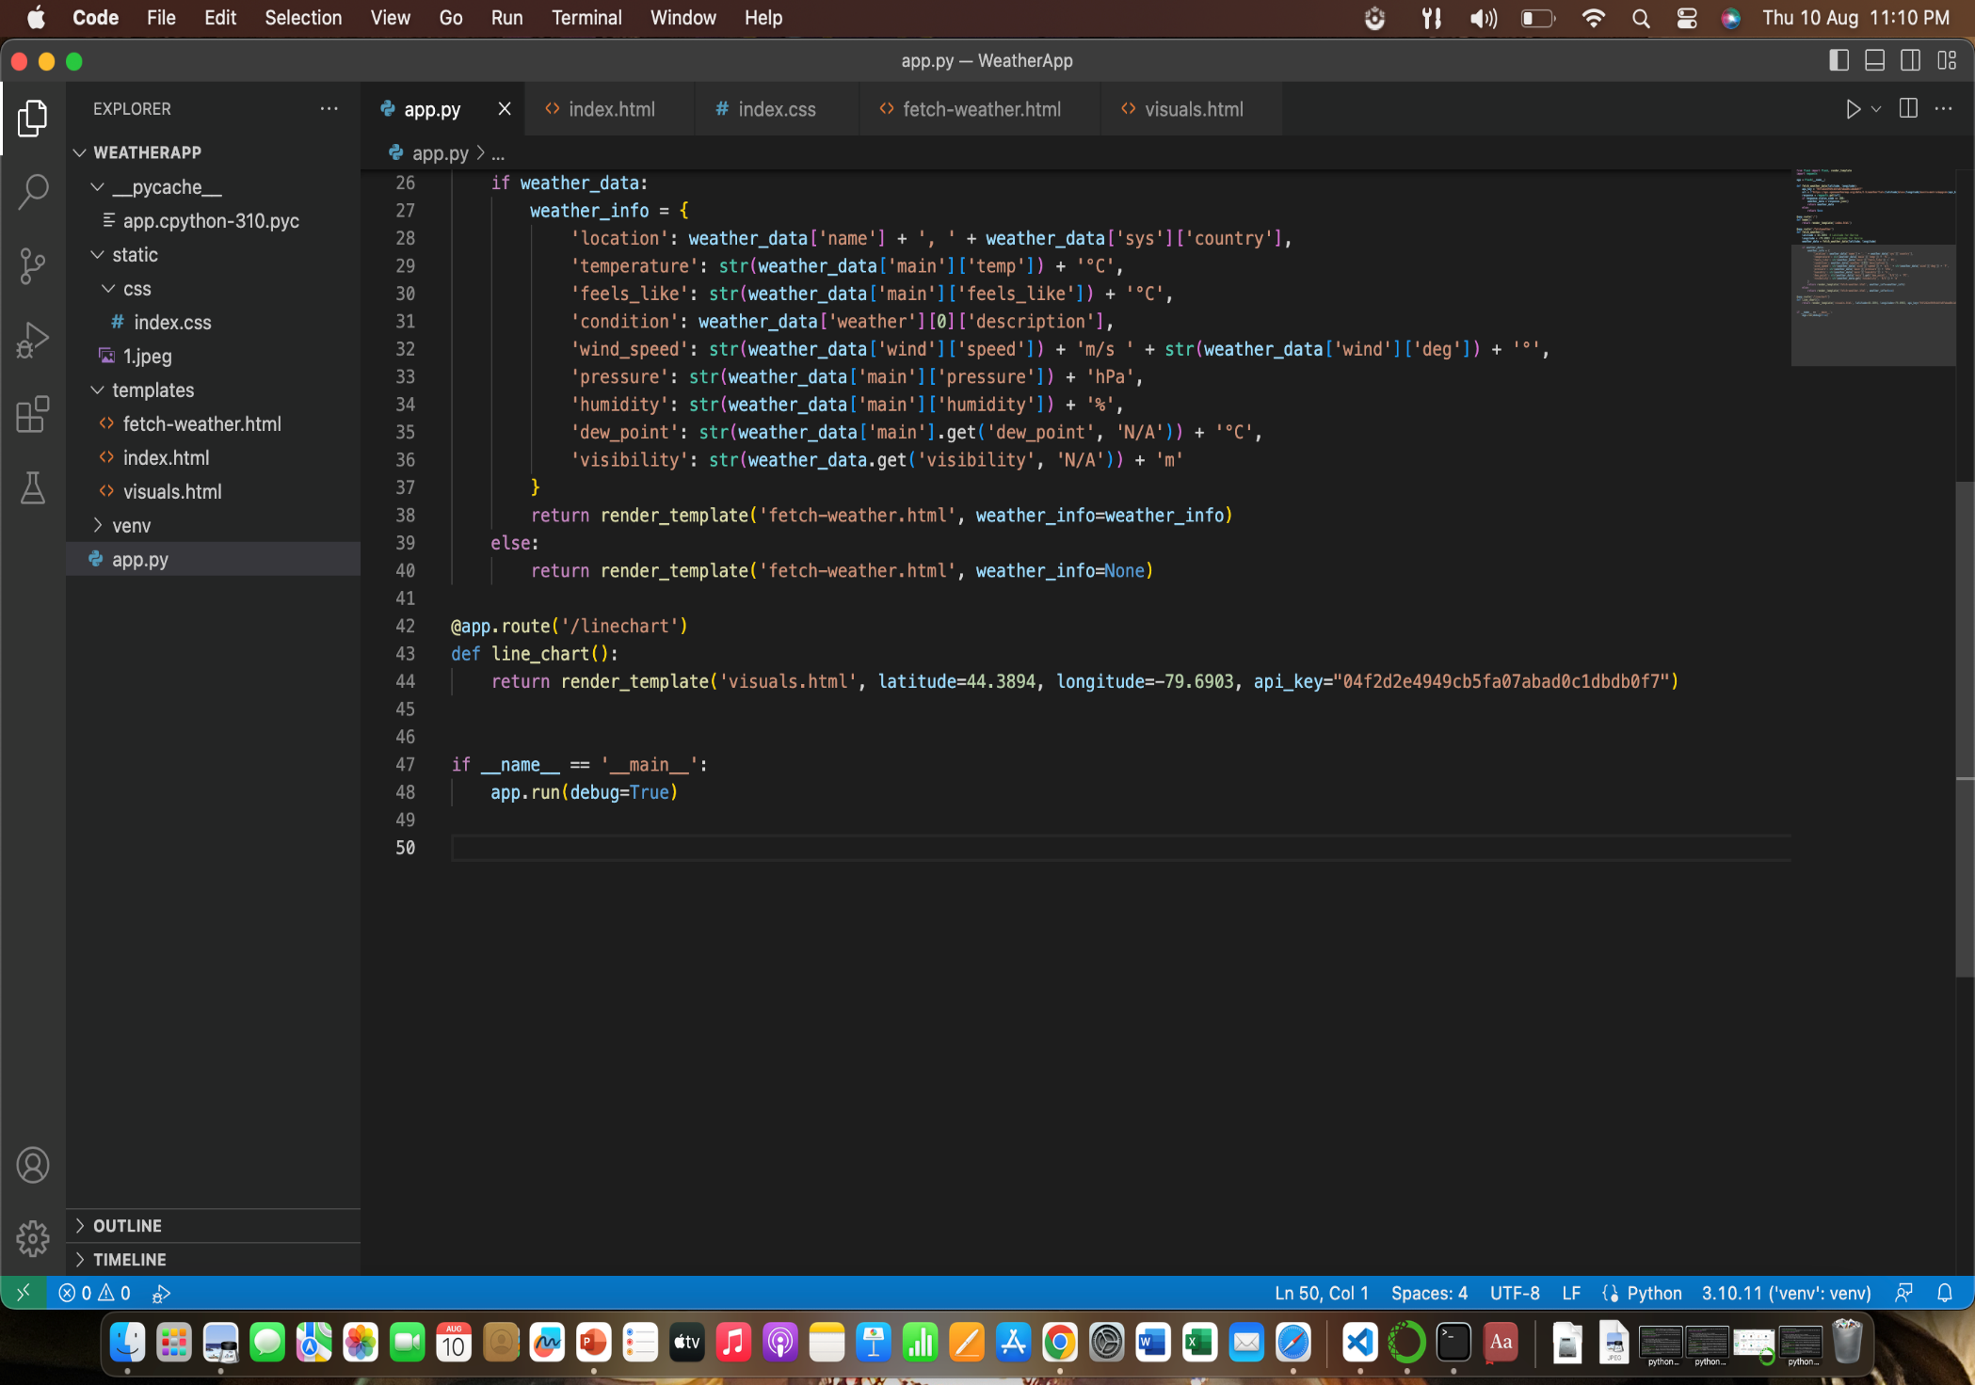
WEB APP CODING

Slide 12
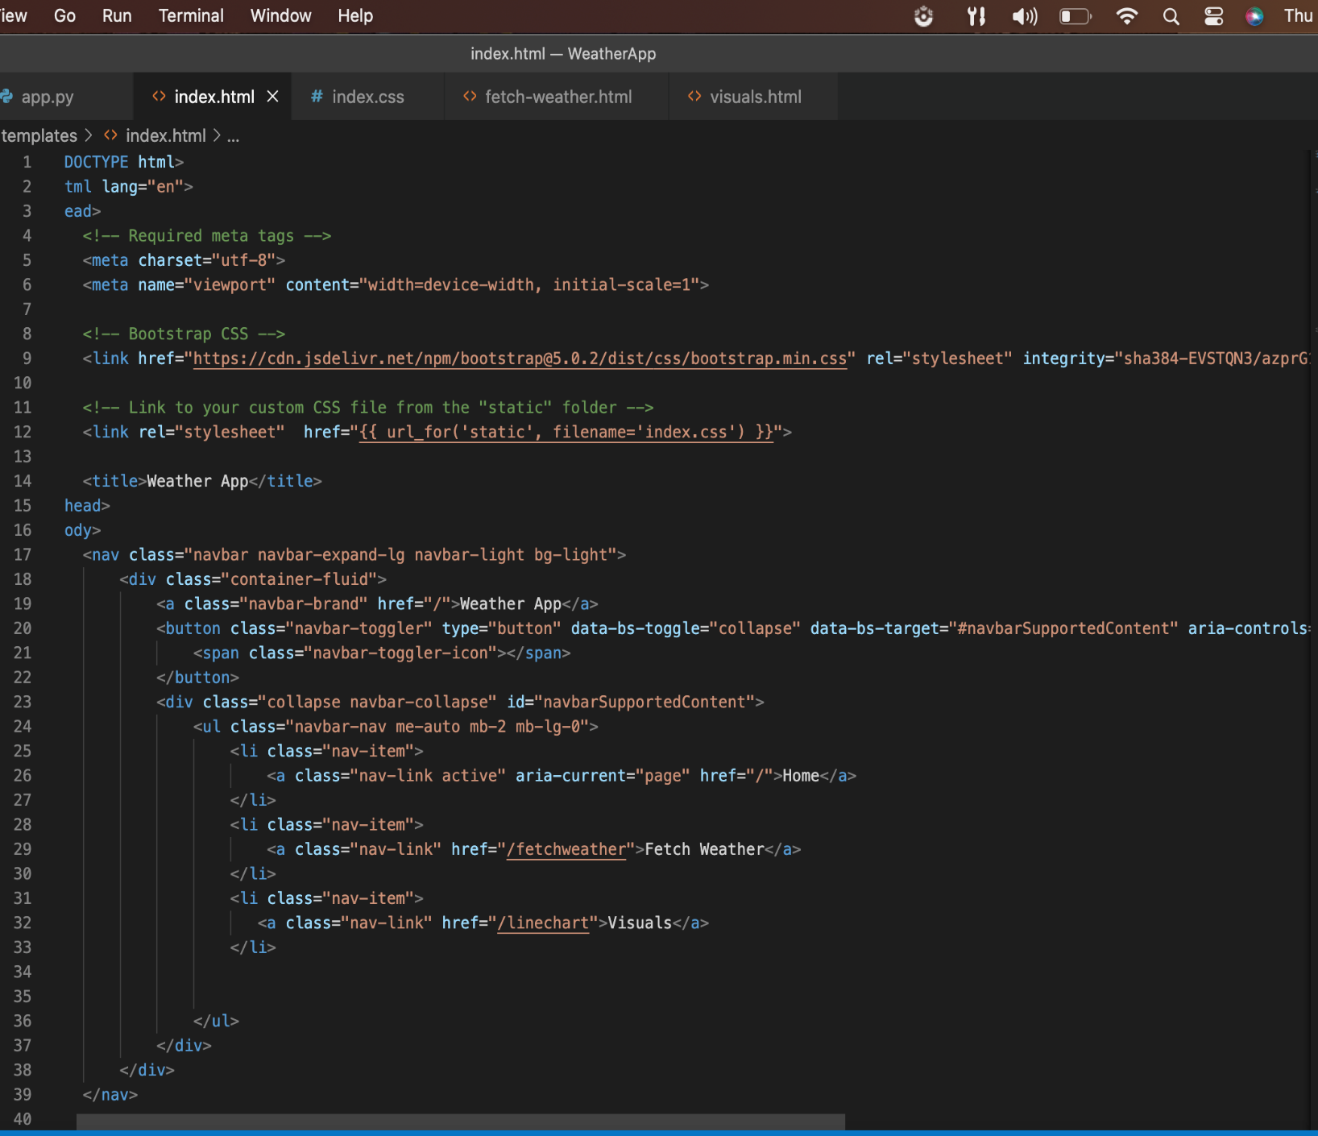
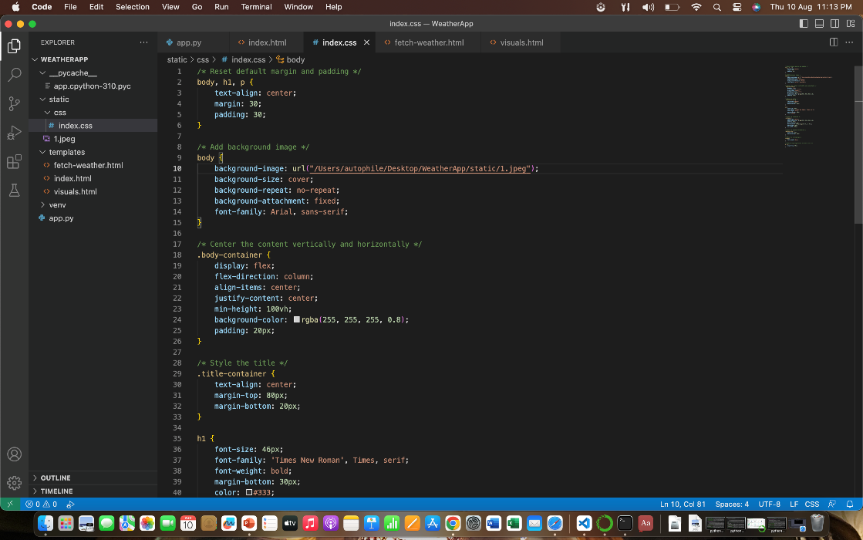

Slide 13
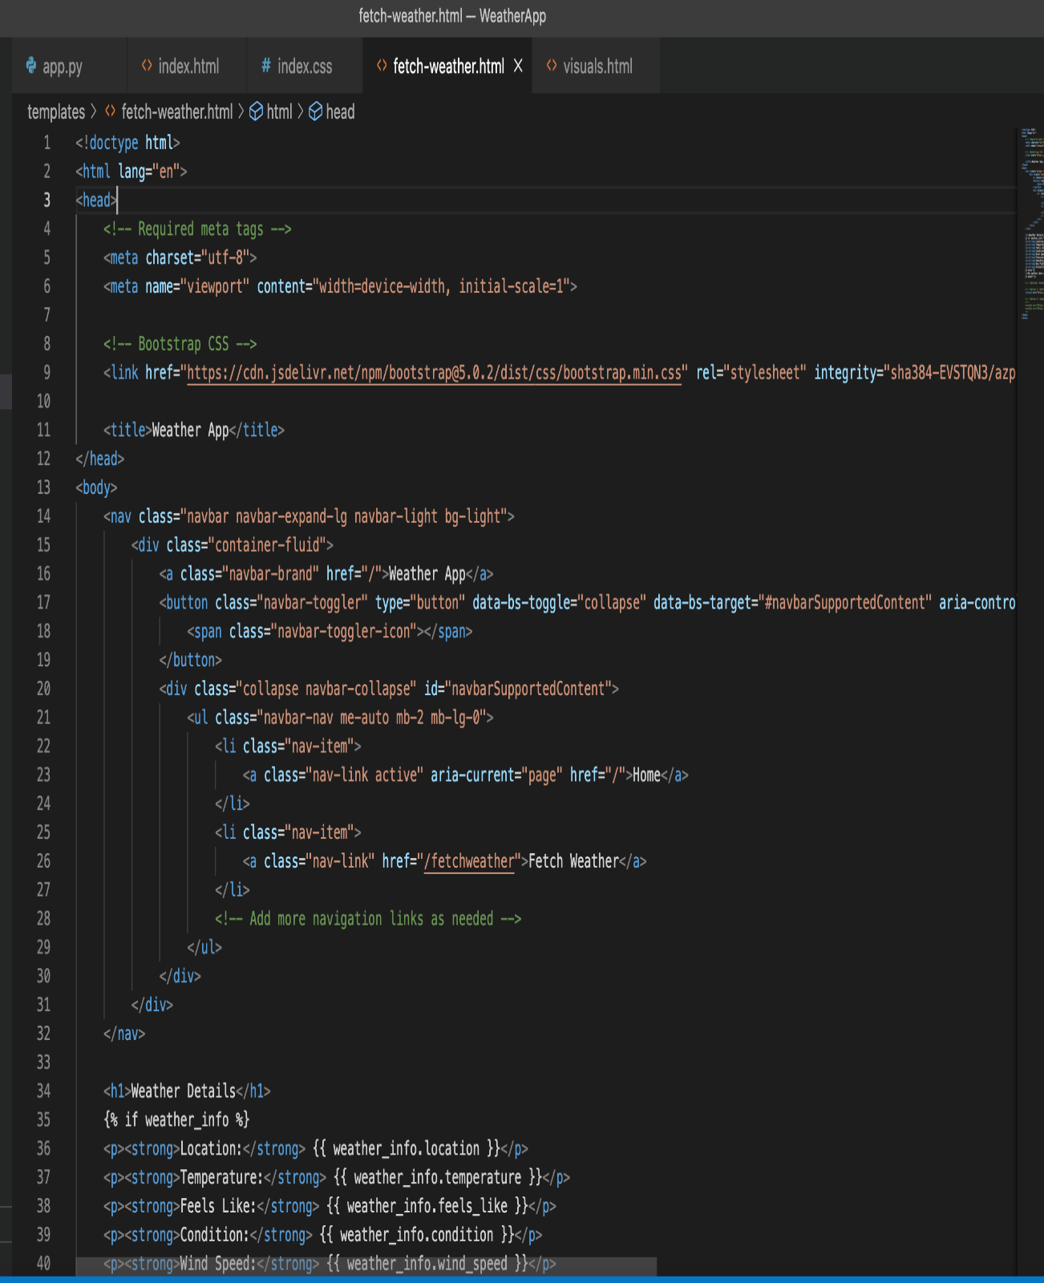
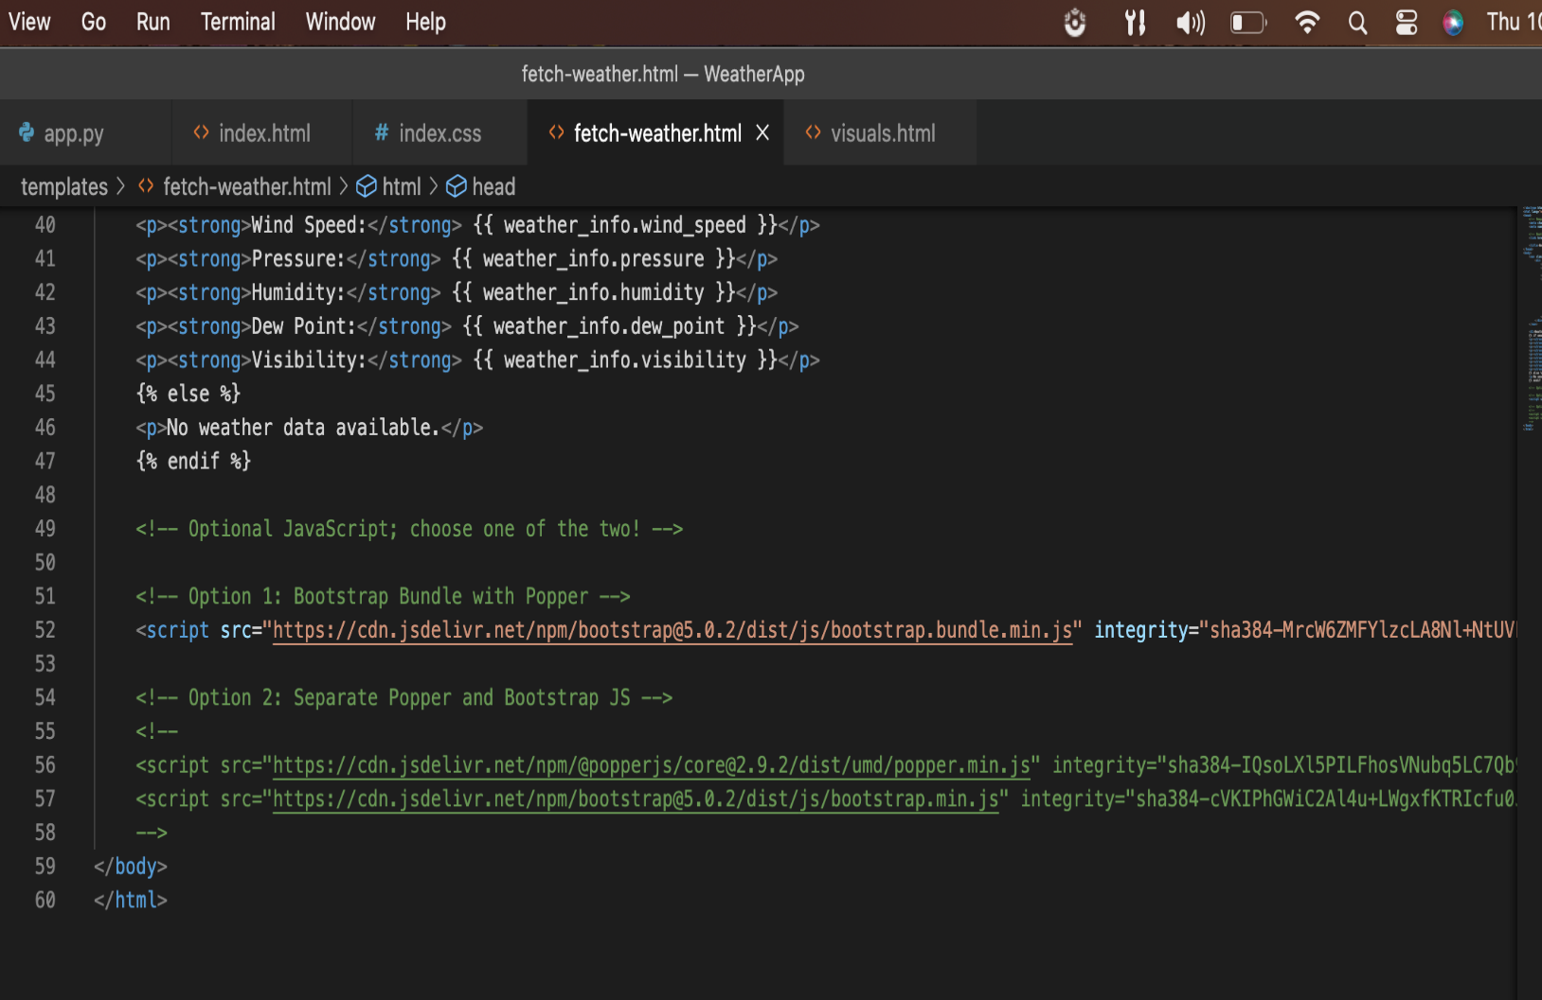

Slide 14
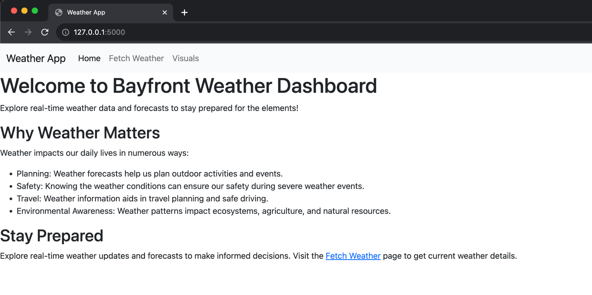
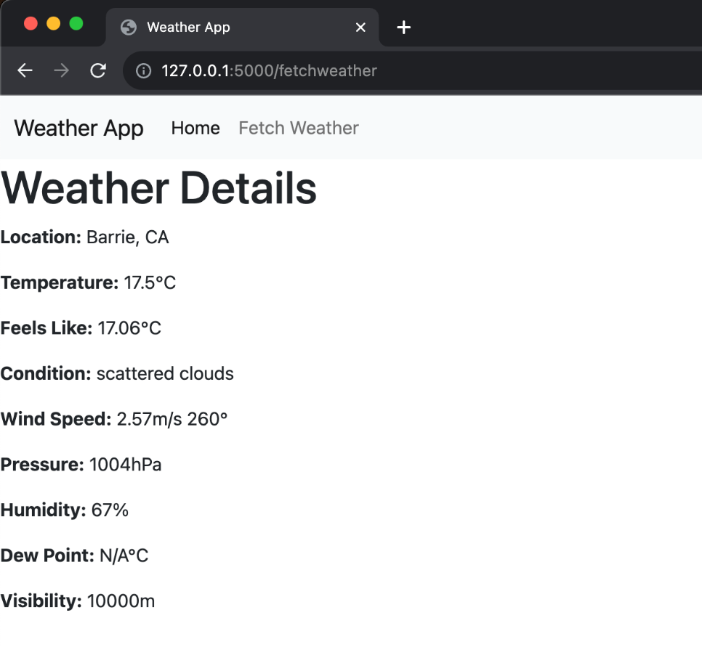
Web application
Overview of the dynamic and user-centric dashboard designed for our Weather Web App. The dashboard aims to provide users with comprehensive and real-time weather information in an intuitive and visually appealing manner.

Slide 15
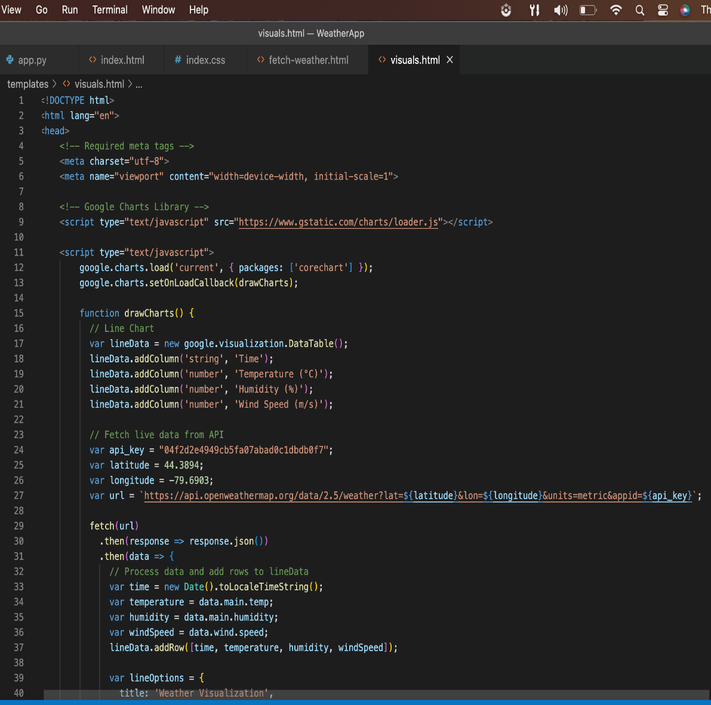
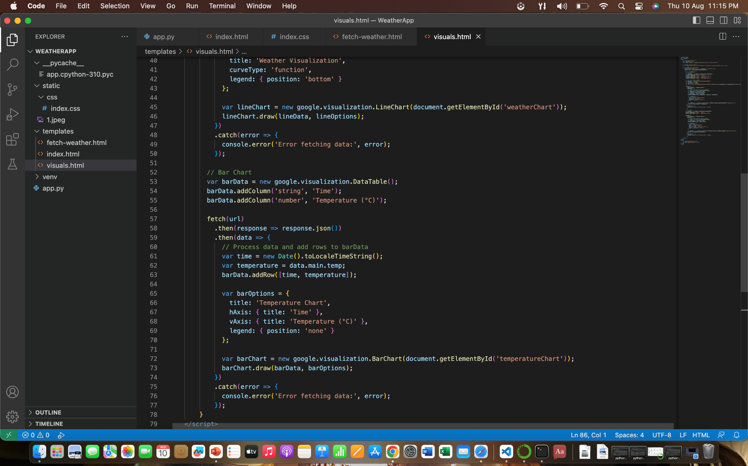
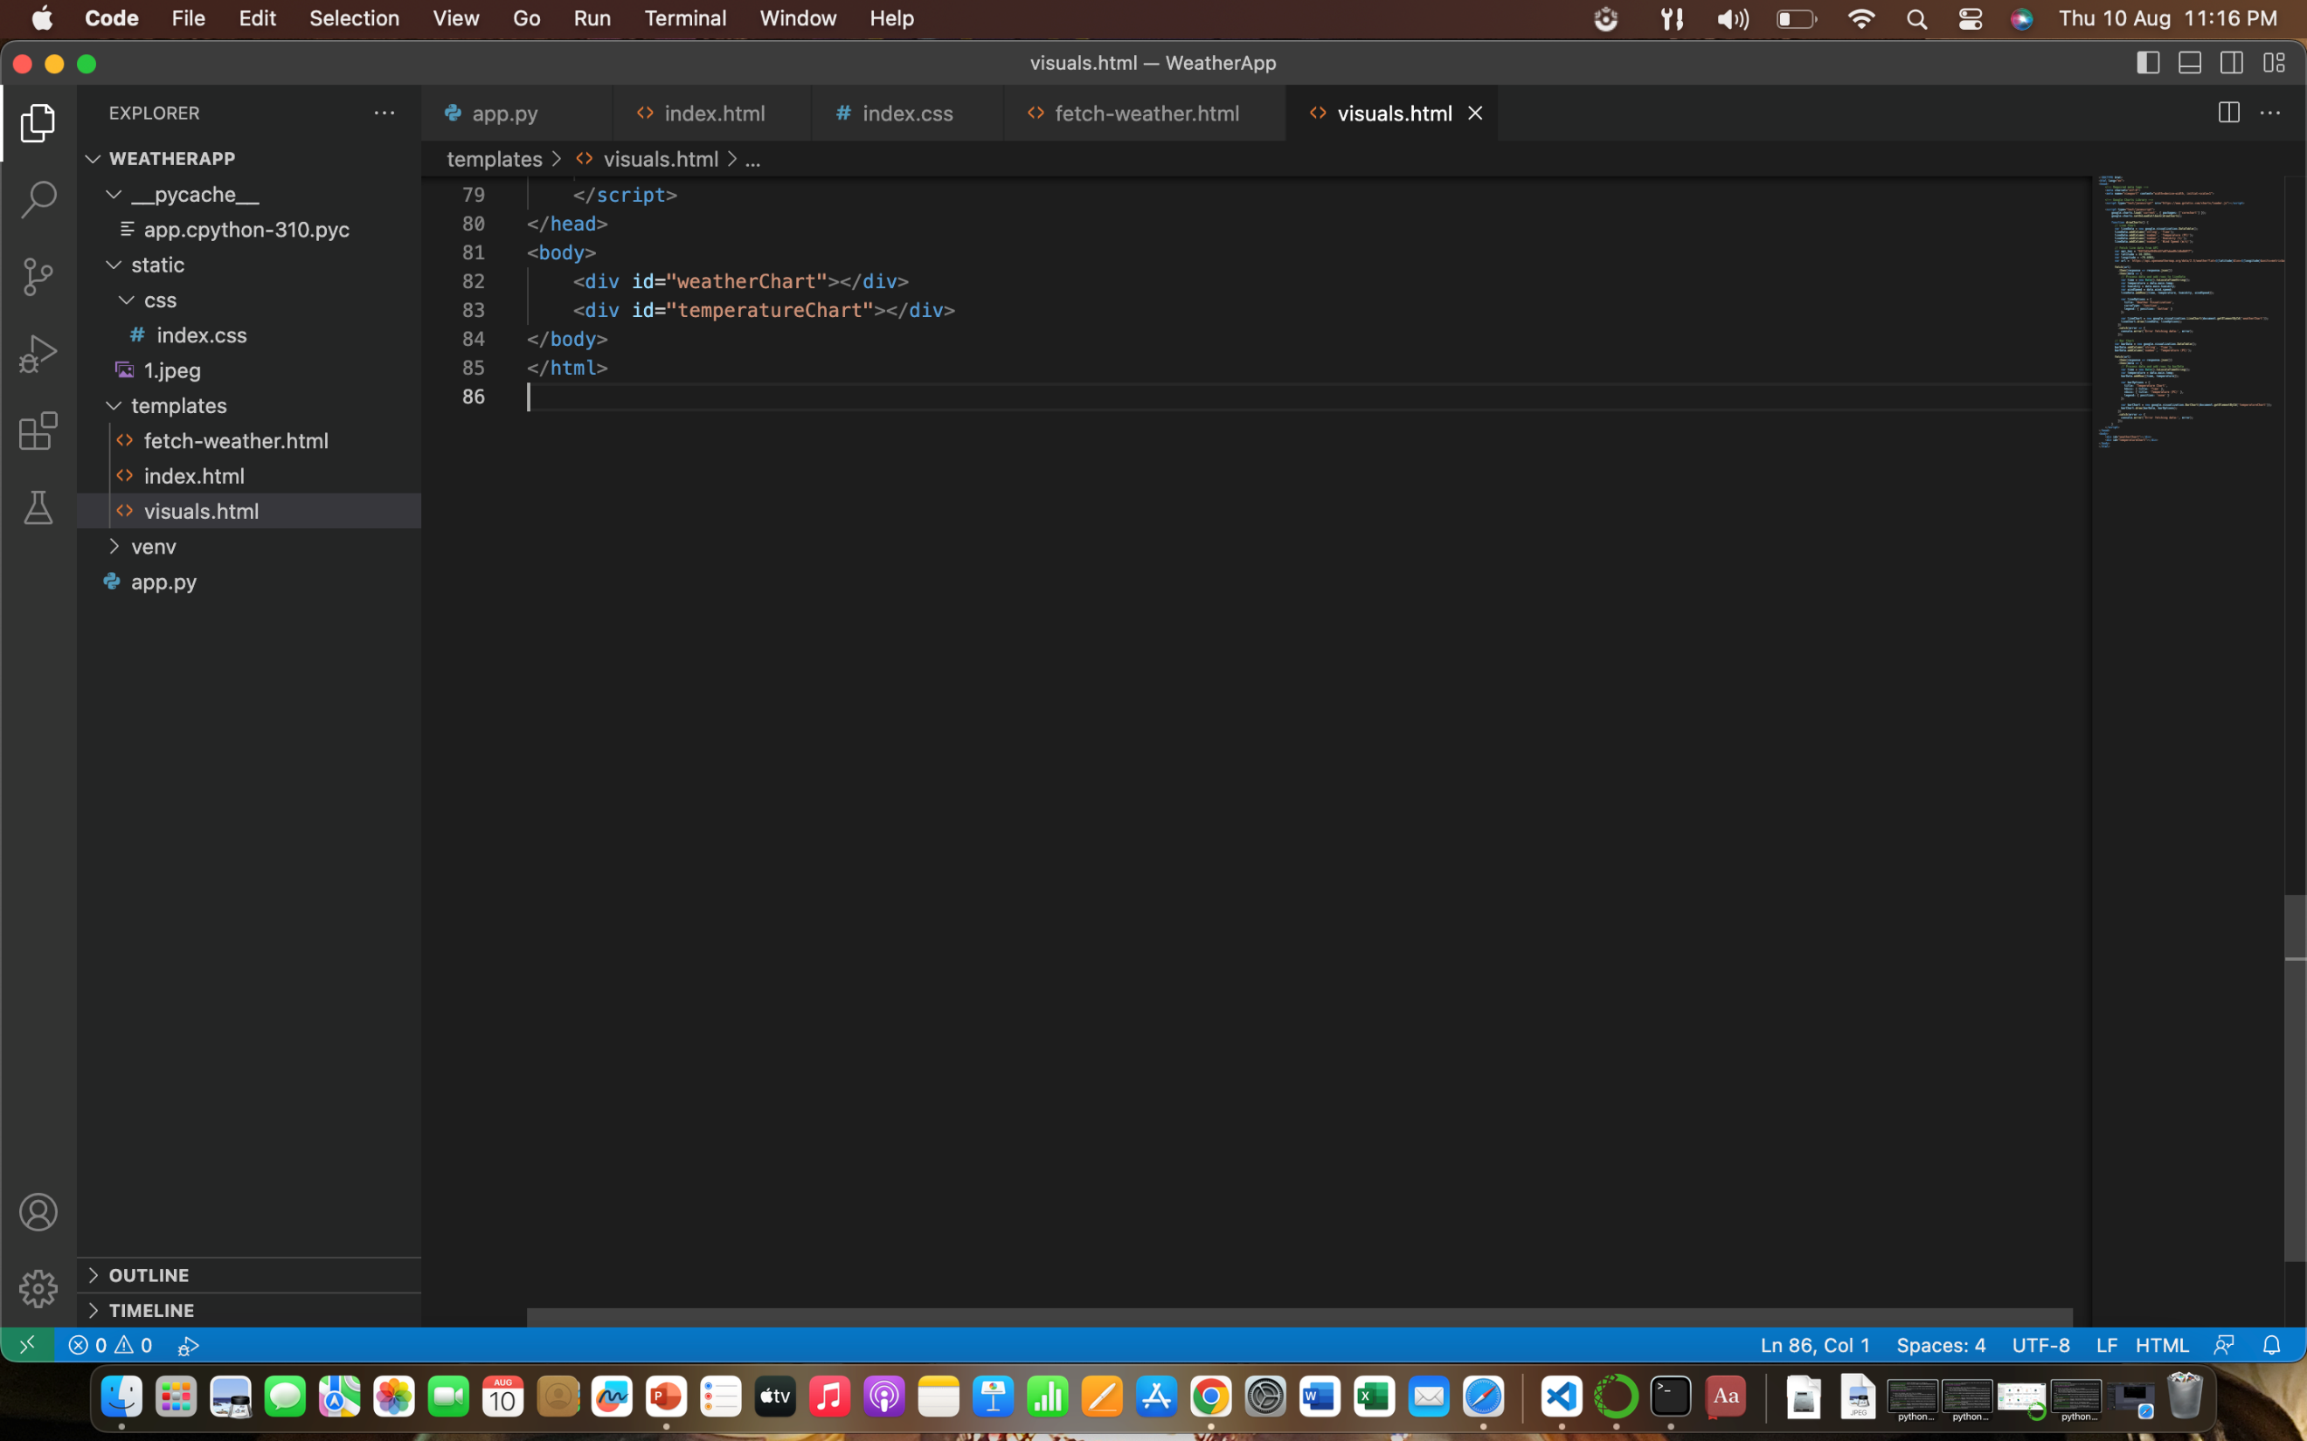
CODE FOR VISUALS

Slide 16
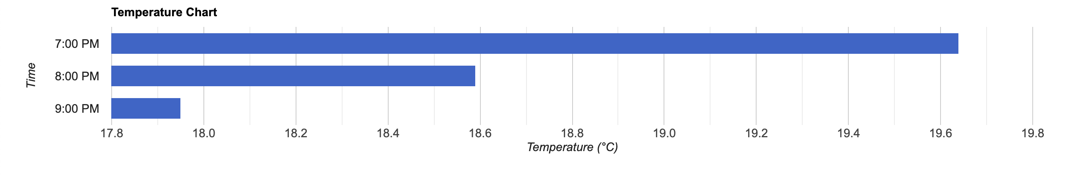
Time vs temperature

Slide 17
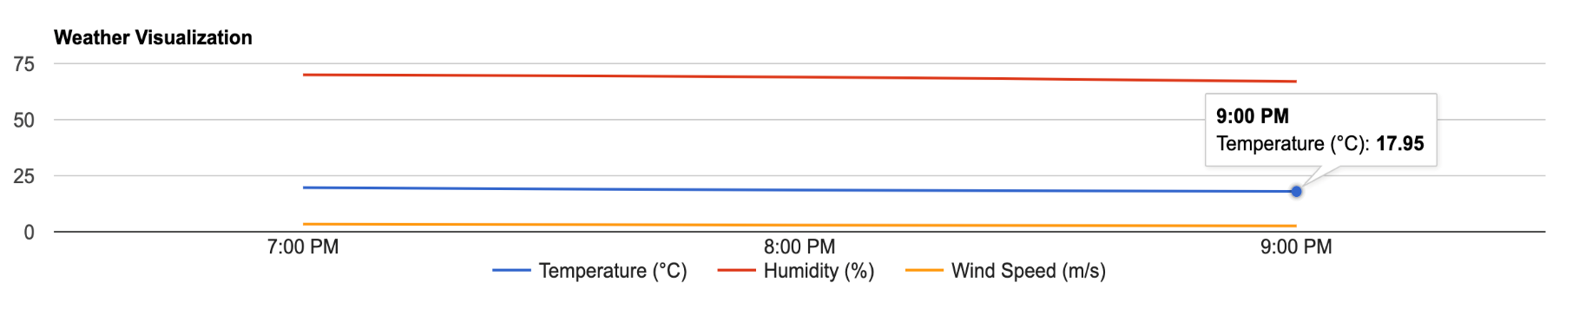
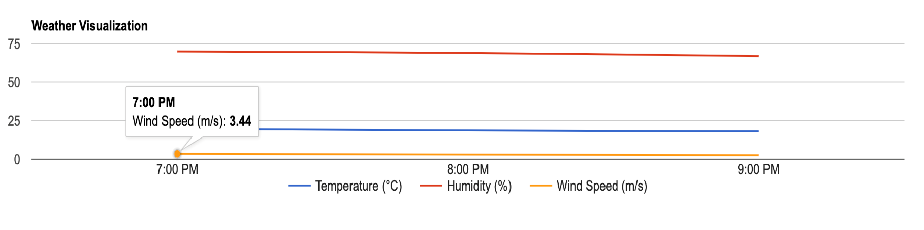
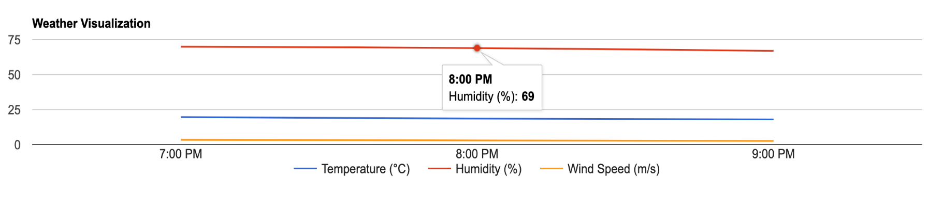
Weather condition

Slide 18
FIT GAP ANALYSIS
Objective: Develop a user-friendly weather app with accurate data.
Current State (As-Is):
Basic text-based weather info.
Simple UI with limited interactivity.
No multiple locations.
No external data sources.
Limited visual representation.
Future State (To-Be) Requirements:
Enhanced UI: Modern design, icons.
Accurate Data: Real-time updates from reliable APIs.
Location Services: Auto/manual input, multiple locations.
Graphical Representation: Interactive charts.
Customization: Alerts, units.
Extended Forecast: Multi-day details.
Identified Gaps:
No data visualization.
No multi-location support.
Limited UI engagement.
Data accuracy issues.
No alerts/customization.
Solutions & Decision
Prioritized Solutions:
Interactive charts for trends.
Multiple location support.
UI redesign for engagement.
Reliable API integration.
Alerts & customization.
Cost & Benefit Analysis:
Costs: Dev time, APIs, UI.
Benefits: Better UX, engagement, accuracy, monetization.
Decision & Implementation:
Decision: Proceed with app development.
Plan: Design, dev, API integration, testing, launch.
Continuous Improvement:
Post-launch: User feedback, updates, improvements.
Adapt to user needs and tech changes.

Slide 19
GIT HUB LINK
https://github.com/anu-siwach/Group.3.BDAT1004FinalProject.git

Slide 20
conclusion
"In conclusion, our weather app embodies the synergy of technology and user experience. By seamlessly integrating data from external apis and utilizing the power of modern web frameworks, we've created a user-friendly platform that empowers users with real-time weather information. The app's ability to fetch, process, and present data not only showcases its technical sophistication but also its practical value in aiding daily decisions – whether it's planning outdoor activities, ensuring safety during adverse weather, or simply staying informed about our surroundings. As we continue to refine and enhance our app, we remain committed to delivering an intuitive and informative tool that keeps users connected to the ever-changing world of weather."

Slide 21
Thank you

